Slide 1
Lecture 2: Overview of Cryptography （I）
An Introduction to Information Security
School of Big Data and Software Engineering, CQU
Fall, 2018

Slide 2
Quickly Review
Lecture 1
Basic Concepts
Security Attack
Interruption
Interception
Modification
Fabrication
Security Services
Confidentiality
Availability
Non-repudiation
Authentication
Integrity
Access Control
Security Model
Active Attack
Passive Attack
Trusted third party
e.g., arbiter, distributor of secret information
④
④
④
Sender
①
Security-related Transformation
①
Security-related Transformation
Recipient
③
Information Channel
Message
Message
Secure Message
Secure Message
②
Secure Information
Opponent
②
Secure Information

Slide 3

Outline
1. WWW Cryptography
2. Classic Cryptography

Slide 4


Lecture 2: Overview of Cryptography
1. WWW Cryptography
2. Classic Cryptography
Terminology: origin
Cryptography: 密码学 (密码编码学)
“crypto” from Greek κρυπτός (secrete) and “graphy” from γράφειν (writing)
“logy” from Greek λογία (study)
Cryptology
密码学
Cryptography
Cryptanalysis
密码编码学
密码分析学

Slide 5
Lecture 2: Overview of Cryptography
1. WWW Cryptography
2. Classic Cryptography
Terminology: semantics
Cryptography 密码编码学
is the practice and study of techniques for secure communication in the presence of third parties (if needed).
More generally, it is about constructing and analyzing protocols that overcome the influence of adversaries (敌手) and which are related to various aspects in information security such as:
confidentiality,
integrity,
authentication, and
non-repudiation.

Slide 6
Lecture 2: Overview of Cryptography
1. WWW Cryptography
2. Classic Cryptography
Terminology: homoionym (近义词)
Cryptography 密码编码学
encrypt, decrypt
encryption, decryption
code, coding
encode, decode
cipher, ciphering
encipher, decipher
encrypt
decrypt
message
code
message
plaintext
ciphertext

Slide 7
Lecture 2: Overview of Cryptography
1. WWW Cryptography
2. Classic Cryptography
Cryptography
Classic Cryptography:（by WWII）
typically for confidential usage
A and B have already shared secret information, to protect their communication
Modern Cryptography （from WWII）
related to more security services, as:
confidentiality,
integrity,
authentication, and
non-repudiation.
Symmetric Cryptography
Asymmetric Cryptography
Modern
Cryptography
Cryptographic Hash Function

Slide 8




Lecture 2: Overview of Cryptography
1. WWW Cryptography
2. Classic Cryptography
Symmetric C-
Symmetric-key cipher：
encryption and decryption with the same secret key
Asymmetric C-
General idea of Symmetric-key cipher
C- Hash Function
Alice
Bob
Plaintext
Plaintext
Encryption Algorithm
Secure Key-exchange Channel
Decryption Algorithm
Shared Secret-Key
Shared Secret-Key
Ciphertext
Ciphertext
Insecure Channel

Slide 9

Lecture 2: Overview of Cryptography
1. WWW Cryptography
2. Classic Cryptography
Symmetric C-
Asymmetric-key cipher:
encryption and decryption with different keys
Asymmetric C-
General idea of Asymmetric-key cipher (1)
C- Hash Function
Alice
Bob
Plaintext
Plaintext
Encryption Algorithm
Alice’s Private-Key
Alice’s
Public Key
Decryption Algorithm
Ciphertext
Ciphertext
Insecure Channel

Slide 10
Lecture 2: Overview of Cryptography
1. WWW Cryptography
2. Classic Cryptography
Symmetric C-
Asymmetric-key cipher:
encryption and decryption with different keys
Asymmetric C-
General idea of Asymmetric-key cipher (2)
C- Hash Function
Alice
Bob
Plaintext
Plaintext
Decryption Algorithm
Encryption Algorithm
Alice’s Private-Key
Alice’s
Public Key
Ciphertext
Ciphertext
Insecure Channel

Slide 11
Lecture 2: Overview of Cryptography
1. WWW Cryptography
2. Classic Cryptography
Symmetric C-
Cryptographic Hash Function: 密码散列函数
with or without secret key
Asymmetric C-
General idea of Hash Function for Message Digest
C- Hash Function
Alice
Bob
message
M digest’
×
Hash
Function
Hash
Function
M digest
M digest
Insecure Channel

Slide 12

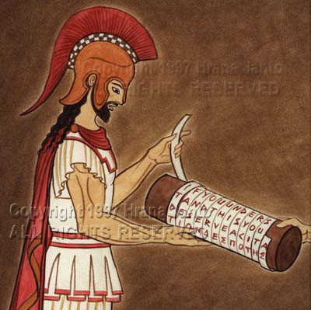
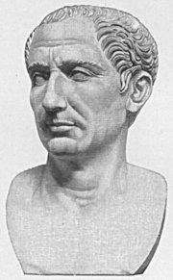

Lecture 2: Overview of Cryptography
1. WWW Cryptography
2. Classic Cryptography
History of Cryptography
2000BC
400BC
Ancient Egypt
Ancient Greek, Rome, China
Middle ages
Arab, Italy: Monoalphabetic
Polyalphabetic ciphers
Rotor Machine German: Enigma
Internet Age
1800-WWII
PKE
DES
1940‘s
1970‘s
AES

Slide 13
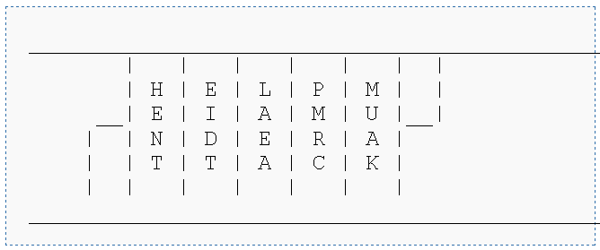
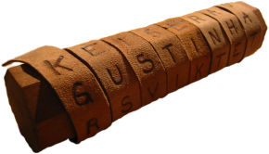

Lecture 2: Overview of Cryptography
1. WWW Cryptography
2. Classic Cryptography
SPARTAN SCYTALE : Please refer to http://en.wikipedia.org/wiki/Scytale

Slide 14
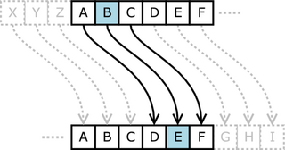
Lecture 2: Overview of Cryptography
1. WWW Cryptography
2. Classic Cryptography
CAESAR CIPHER: Please refer to http://en.wikipedia.org/wiki/Caesar_cipher
A
B
C
D
E
F
G
H
I
J
K
L
M
N
O
P
Q
R
S
T
U
V
W
X
Y
Z
D
E
F
G
H
I
J
K
L
M
N
O
P
Q
R
S
T
U
V
W
X
Y
Z
A
B
C
Caesar’s Order
YOU MUST ATTACK AT MIDNIGHT
Cipher-Text
BRX PXVW DWWDFN DW PLGQLJKW

Slide 15
Lecture 2: Overview of Cryptography
1. WWW Cryptography
2. Classic Cryptography
truth of the two most classic cipher
Transposition(置换) cipher
Substitution(替换) cipher
Q1
What are the differences between them ?
changes location of the symbols
replaces one symbol with another

Slide 16
Lecture 2: Overview of Cryptography
1. WWW Cryptography
2. Classic Cryptography
truth of the two most classic cipher
Transposition(置换) cipher
Substitution(替换) cipher
Q1
What are the differences between them ?
Q2
What are the secret keys of them ? (how to set keys)
棱柱侧面的数量{x}
移位的长度 {s}

Slide 17
Lecture 2: Overview of Cryptography
1. WWW Cryptography
2. Classic Cryptography
truth of the two most classic cipher
Transposition(置换) cipher
Substitution(替换) cipher
Q1
What are the differences between them ?
Q2
What are the secret keys of them ? (how to set keys?)
Q3
What are d/encryption algorithms? (how to transform?)
明文一维数组->多维数组-行列变换->密文一维数组密文
字符编码后的加法运算

Slide 18
Lecture 2: Overview of Cryptography
1. WWW Cryptography
2. Classic Cryptography
CAESAR CIPHER : algorithm
simplest mono-alphabetic cipher (单码代换密码)
shift cipher, additive cipher
a
b
c
d
e
f
g
h
i
j
k
l
m
n
o
p
q
r
s
t
u
v
w
x
y
z
A
B
C
D
E
F
G
H
I
J
K
L
M
N
O
P
Q
R
S
T
U
V
W
X
Y
Z
00
01
02
03
04
05
06
07
08
09
10
11
12
13
14
15
16
17
18
19
20
21
22
23
24
25
Plaintext
Plaintext
Alice
Bob
C=(P+k) mod 26
P=(C-k) mod 26
Encryption
Ciphertext
decryption
encrypt the message “hello” with key 17.

Slide 19
Lecture 2: Overview of Cryptography
1. WWW Cryptography
2. Classic Cryptography
truth of the two most classic cipher
Transposition(置换) cipher
Substitution(替换) cipher
Q1
What are the differences between them ?
Q2
What are the secret keys of them ? (how to set keys?)
Q3
What are d/encryption algorithms? (how to transform?)
Q4
What are your comments of the ciphers? (Secure?)
1: statistics
2: length of key: too short

Slide 20
Lecture 2: Overview of Cryptography
1. WWW Cryptography
2. Classic Cryptography
Upgraded Ciphers: Polyalphabetic (多码代换) Ciphers
①Auto-key Cipher
②Playfair Cipher
③Vigenère Cipher
④Hill Cipher

Slide 21

Lecture 2: Overview of Cryptography
1. WWW Cryptography
2. Classic Cryptography
Upgraded Ciphers: Polyalphabetic (多码代换) Ciphers
①Auto-key Cipher
②Playfair Cipher
③Vigenère Cipher
④Hill Cipher
P=p₁p₂p₃…… C=c₁c₂c₃…… k=（k₁, p₁, p₂…）
Encryption: c_{i} =（p_{i} + k_{i}） mod 26
Decryption: p_{i} =（c_{i} - k_{i}） mod 26
Plaintext
a t t a c k i s t o d a y
P value
00 19 19 00 02 10 08 18 19 14 03 00 24
key
12
key stream
12 00 19 19 00 02 10 08 18 19 14 03 00
C Value
12 19 12 19 02 12 18 00 11 07 17 03 24
ciphertext
M T M T C M S A L H R D Y

Slide 22
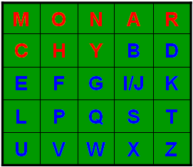
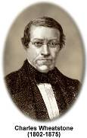
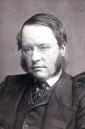
Lecture 2: Overview of Cryptography
1. WWW Cryptography
2. Classic Cryptography
Upgraded Ciphers: Polyalphabetic (多码代换) Ciphers
①Auto-key Cipher
②Playfair Cipher
③Vigenère Cipher
④Hill Cipher
e.g. Key=MONARCHY
Secret Key
Let us encrypt the plaintext “hello” using the key in above table.
he
CF
lx
SU
lo
MP
Lyon Playfair
1818-1898
Plaintext:
hello
Ciphertext:
CFSUMP

Slide 23
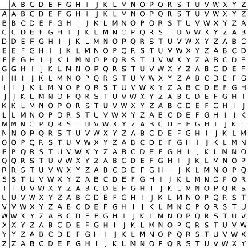
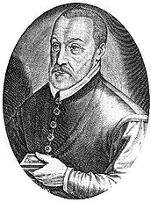
Lecture 2: Overview of Cryptography
1. WWW Cryptography
2. Classic Cryptography
Upgraded Ciphers: Polyalphabetic (多码代换) Ciphers
①Auto-key Cipher
②Playfair Cipher
③Vigenère Cipher
④Hill Cipher
Encryption
Decryption
Plaintext: ATTACKATDAWN
Keyword: LEMON
Keyword: LEMONLEMONLE
Cipertext:
Blaise de Vigenère
L
X
F
O
P
V
E
F
R
N
H
R

Slide 24
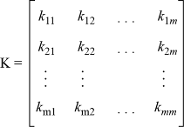
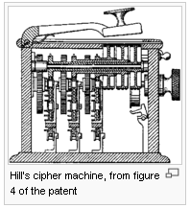
Lecture 2: Overview of Cryptography
1. WWW Cryptography
2. Classic Cryptography
Upgraded Ciphers: Polyalphabetic (多码代换) Ciphers
①Auto-key Cipher
②Playfair Cipher
③Vigenère Cipher
④Hill Cipher
The Hill cipher is a polygraphic substitution cipher based on linear algebra. Invented by Lester S. Hill in 1929, it was the first polygraphic cipher in which it was practical (though barely) to operate on more than three symbols at once.

Slide 25
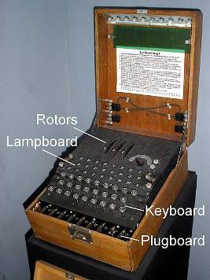
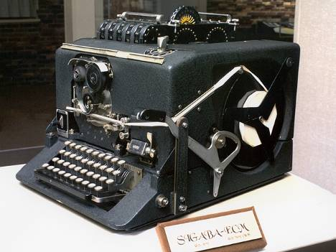
Lecture 2: Overview of Cryptography
1. WWW Cryptography
2. Classic Cryptography
Rotors Machines : WWII
Enigma
SIGABA

Slide 26
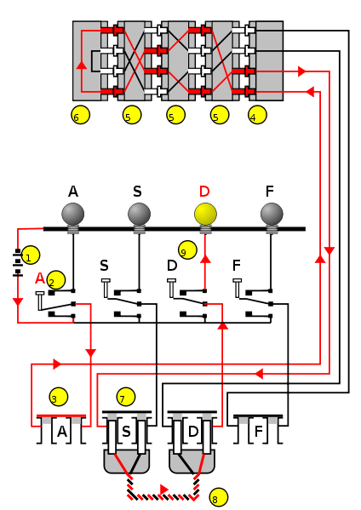
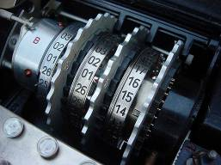
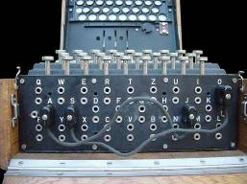
Lecture 2: Overview of Cryptography
1. WWW Cryptography
2. Classic Cryptography
How Enigma works?

Slide 27
Lecture 2: Overview of Cryptography
1. WWW Cryptography
2. Classic Cryptography
One Rotor demo

Slide 28
Lecture 2: Overview of Cryptography
Summary
Modern Cryptography
Classic Cryptography
Substitution
Transposition
Symmetric Cryptography
Asymmetric Cryptography
Modern
Cryptography
Cryptographic Hash Function

Slide 29
An Introduction to Information Security
Thanks for your attention!
Q&A

